Slide 1
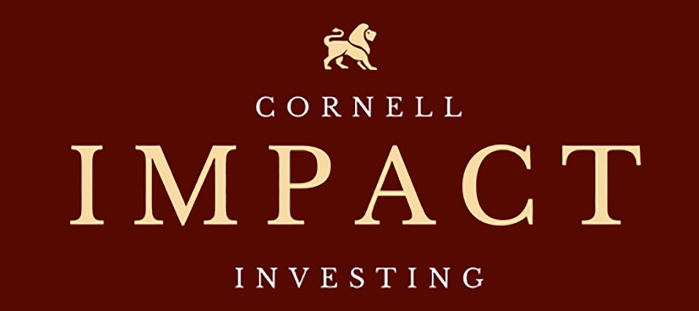

Team Red Horse: Lily, Junan, Rachel, & Ellen

Slide 2

About the Client
Cornell Impact Investing
Club at Cornell that aims to create sustainable investment models, and to work with impact investment firms, in order to provide research support to help challenge market and social issues.
Mission:
“Given our global political climate, it has become more important now than ever before to understand and take responsibility for the implications of our actions as citizens of the world. I strongly believe that impact investing allows people the opportunity to do just that.”

Slide 3



Target Audiences
Business partners
Prospective recruits
Current analysts

Slide 4



Problems
Cornell Impact Investing is a new club without a website
They want to establish credibility for future partnerships
Need a way to educate and encourage potential applicants to join

Slide 5



Our Solutions
Create a modern and professional website to help them establish credibility as a club and for seeking partnerships
Include educational resources to educate current members as well as teach potential recruits more about impact investing
Applications for potential members

